Slide 1
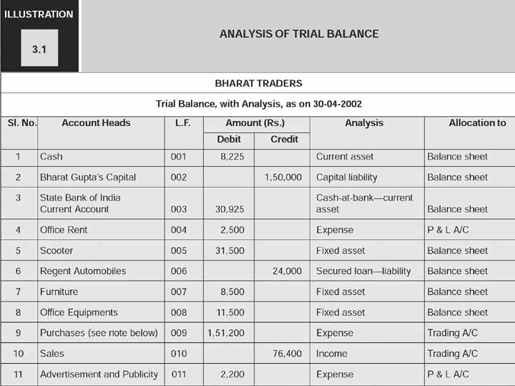
• Measurement of Business Income and Financial Position
• Trial Balance to Balance Sheet and Profit and Loss Account
10/10/2020
FRMA - Dr. Gaurav Agrawal,ABV-IIITM

Slide 2
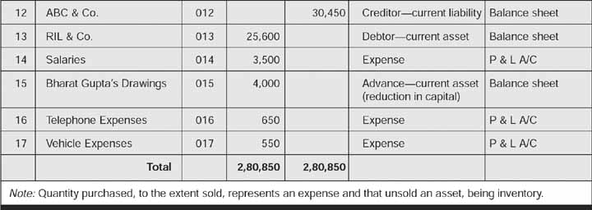
10/10/2020
FRMA - Dr. Gaurav Agrawal,ABV-IIITM

Slide 3
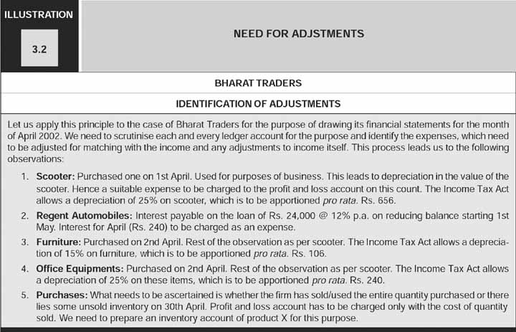
▪Need for adjustments
10/10/2020
FRMA - Dr. Gaurav Agrawal,ABV-IIITM

Slide 4
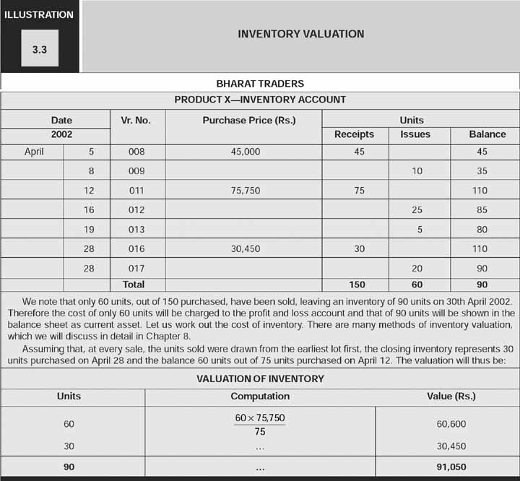
▪Inventory valuation
10/10/2020
FRMA - Dr. Gaurav Agrawal,ABV-IIITM

Slide 5
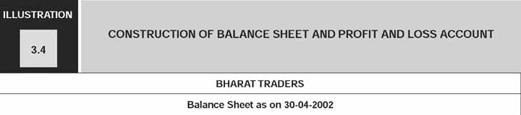
▪Construction of balance sheet and profit and
Loss account
10/10/2020
FRMA - Dr. Gaurav Agrawal,ABV-IIITM

